Slide 1









User Analytics
Trainity project by Kamlesh Kaldate

Slide 2

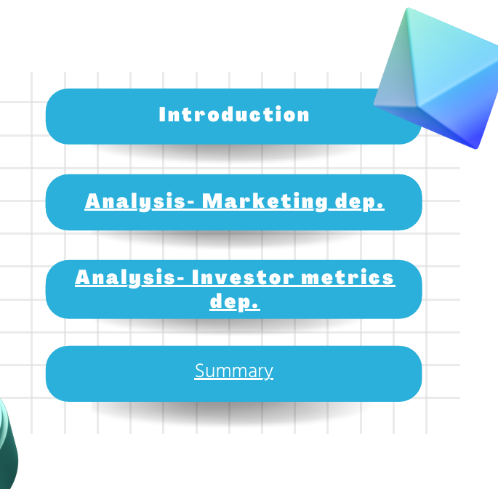


Contents

Slide 3

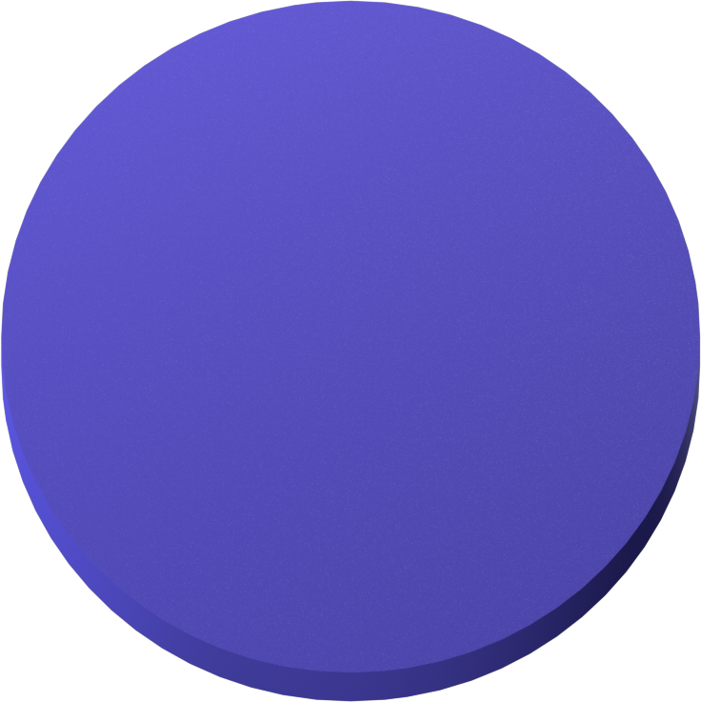


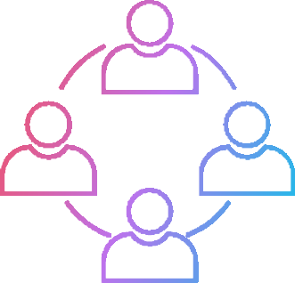

Introduction
In this project, we are supposed to provide a detailed report for the Marketing and Investor metrics department. this analysis will help them make a decision based on different metrics and insights.
Marketing Investor metrics

Slide 4

Find the 5 oldest users of the Instagram from the database provided
01
REWARDING MOST LOYAL USERS
REMIND INACTIVE USERS TO START POSTING
Find the users who have never posted a single photo on
Instagram
02
Identify the winner of the
contest and provide their details to the team
03
DECLARING CONTEST WINNER
HASHTAG RESEARCHING
Identify and suggest the top 5 most commonly used hashtags on the platform
04
What day of the week do most users register on? Provide
insights on when to schedule an ad campaign
LAUNCH AD CAMPAIGN
05

Slide 5

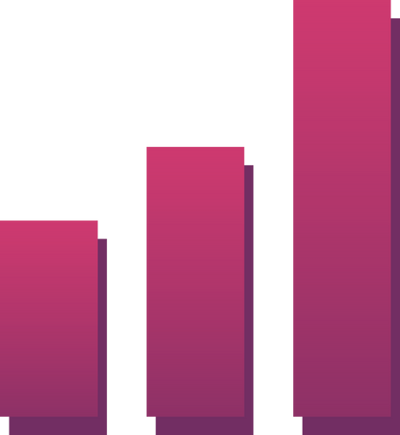




Investor Metrics:
2.Bots & Fake Accounts:
1.User Engagement:
Provide how many times does average user posts on Instagram. Also, provide the total number of photos on Instagram/total number of users
Provide data on users (bots) who have liked every single photo on the site (since any normal user would not be able to do this).

Slide 6
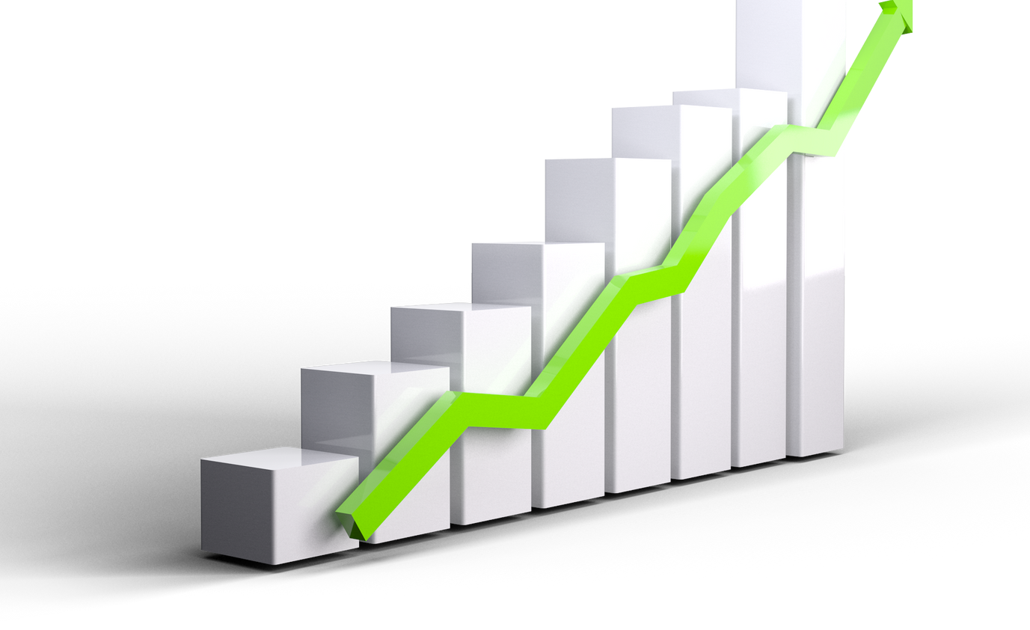


Rewarding the most loyal users
TOP 5 OLDEST USERS
01
02
03
04
05
Darby_Herzog
2016-05-06
Emilio_Bernier52
2016-05-06
Elenor88
2016-05-08
Nicole71
2016-05-09
Jordyn.Jacobson2
2016-05-14

Slide 7













Remind Inactive users to start posting
We have found a list of 26 people with their user id who have never posted a single photo on Instagram. they'll be receiving promotional emails to post their 1st photo.
5-Aniya_Hackett
7-Kasandra_Homenick 14-Jaclyn81
21-Rocio33
24-Maxwell.Halvorson 25-Tierra.Trantow
34-Pearl7
36-Ollie_Ledner37 41-Mckenna17
45-David.Osinski47
49-Morgan.Kassulke 53-Linnea59
54-Duane60
57-Julien_Schmidt 66-Mike.Auer39
68-Franco_Keebler64 71-Nia_Haag
74-Hulda.Macejkovic 75-Leslie67
76-Janelle.Nikolaus81
80-Darby_Herzog 81-Esther.Zulauf61
83-Bartholome.Bernhard 89-Jessyca_West
90-Esmeralda.Mraz57 91-Bethany20
REMINDER

Slide 8







Declaring contest winner
In the contest, the user with the most likes on a single picture won
Details-
User Id
52
Username
Zack_Kemmer93
Image_url
https://jarret.name
Likes
48

Slide 9





# Hashtag Researching
MARKETING DEPARTMENT
Top 5 hashtags that are most frequently used on Instagram
#Smile
#Beach
#Party
42
59
#Fun
#Concert
39
24
38

Slide 10

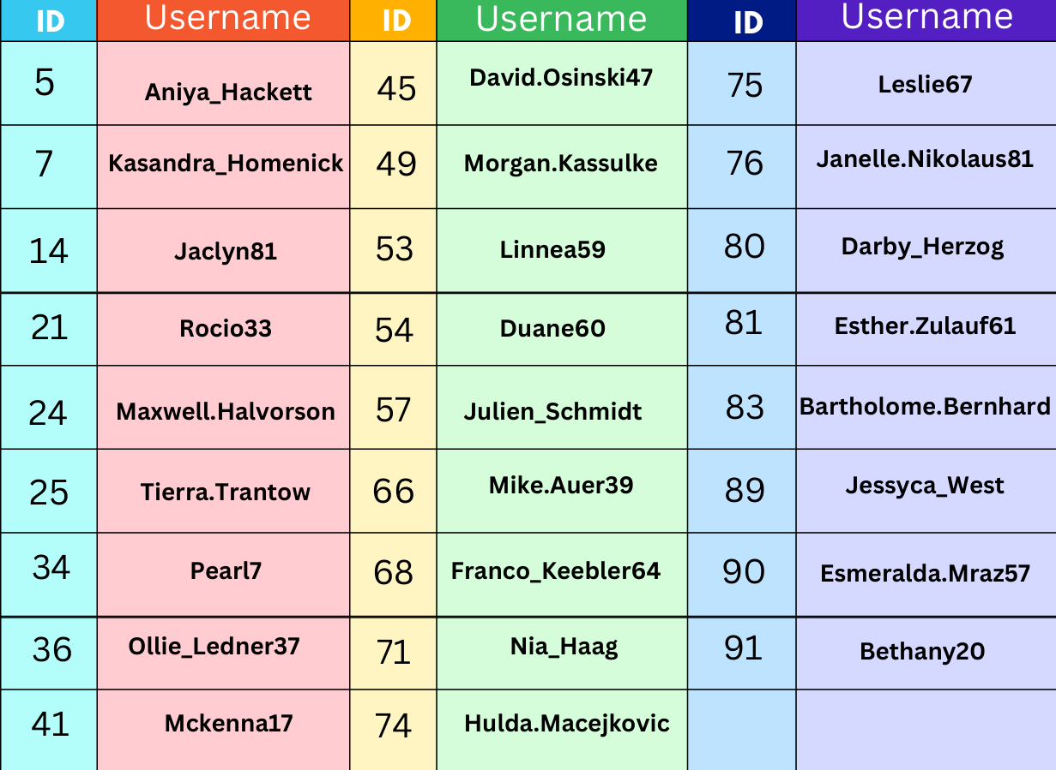
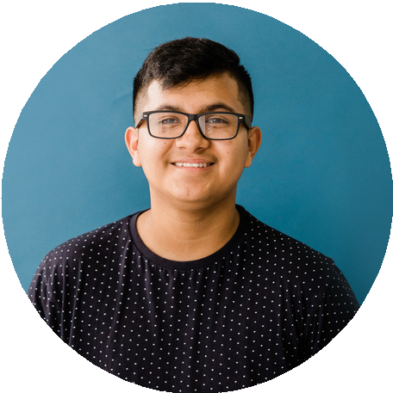
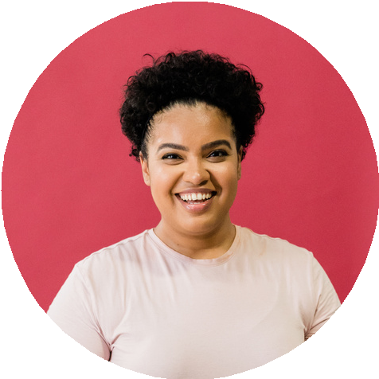
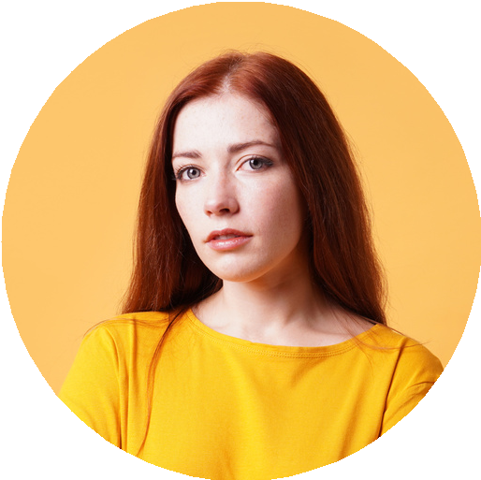


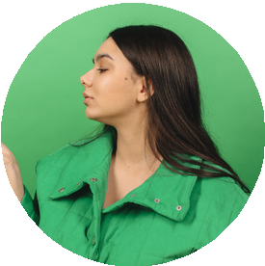
TABULAR REPRSENTATION
ID
Username
ID
Username
ID
Username

Slide 11





Launch AD campaign
Registrants are most active on this day of the week
20
Thursday
16
Sunday
16
15
10
5
0
The best time to schedule an advertisement campaign is on Thursday and Sunday
Thursday
Sunday
Friday
Tuesday
Monday
Saturday
Wednesday
16
Sunday
15
Tuesday
14
Wednesday
12
Thursday
Friday
Monday
Saturday
16
14
13

Slide 12

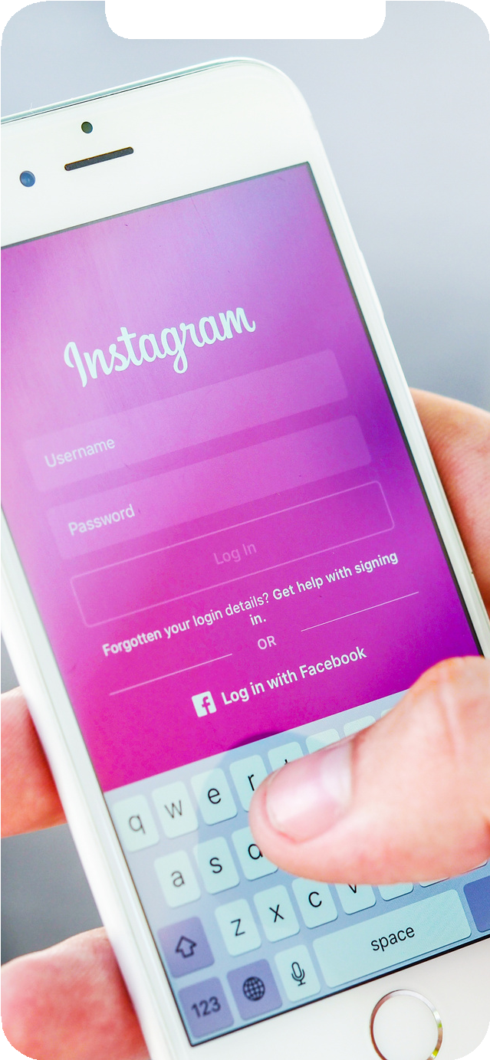
User Engagement
Based on the results, there are -
74 Active users who have posted at least once. 100 Total users (as per the data)
257 Total posts made.
Total Photos/Total users = 257/100 = 2.57
so the average will be 257/74 = 3.47, Based on the data we can say that an average user posts 3-4 times.
74%
257/74 = 3.47

Slide 13
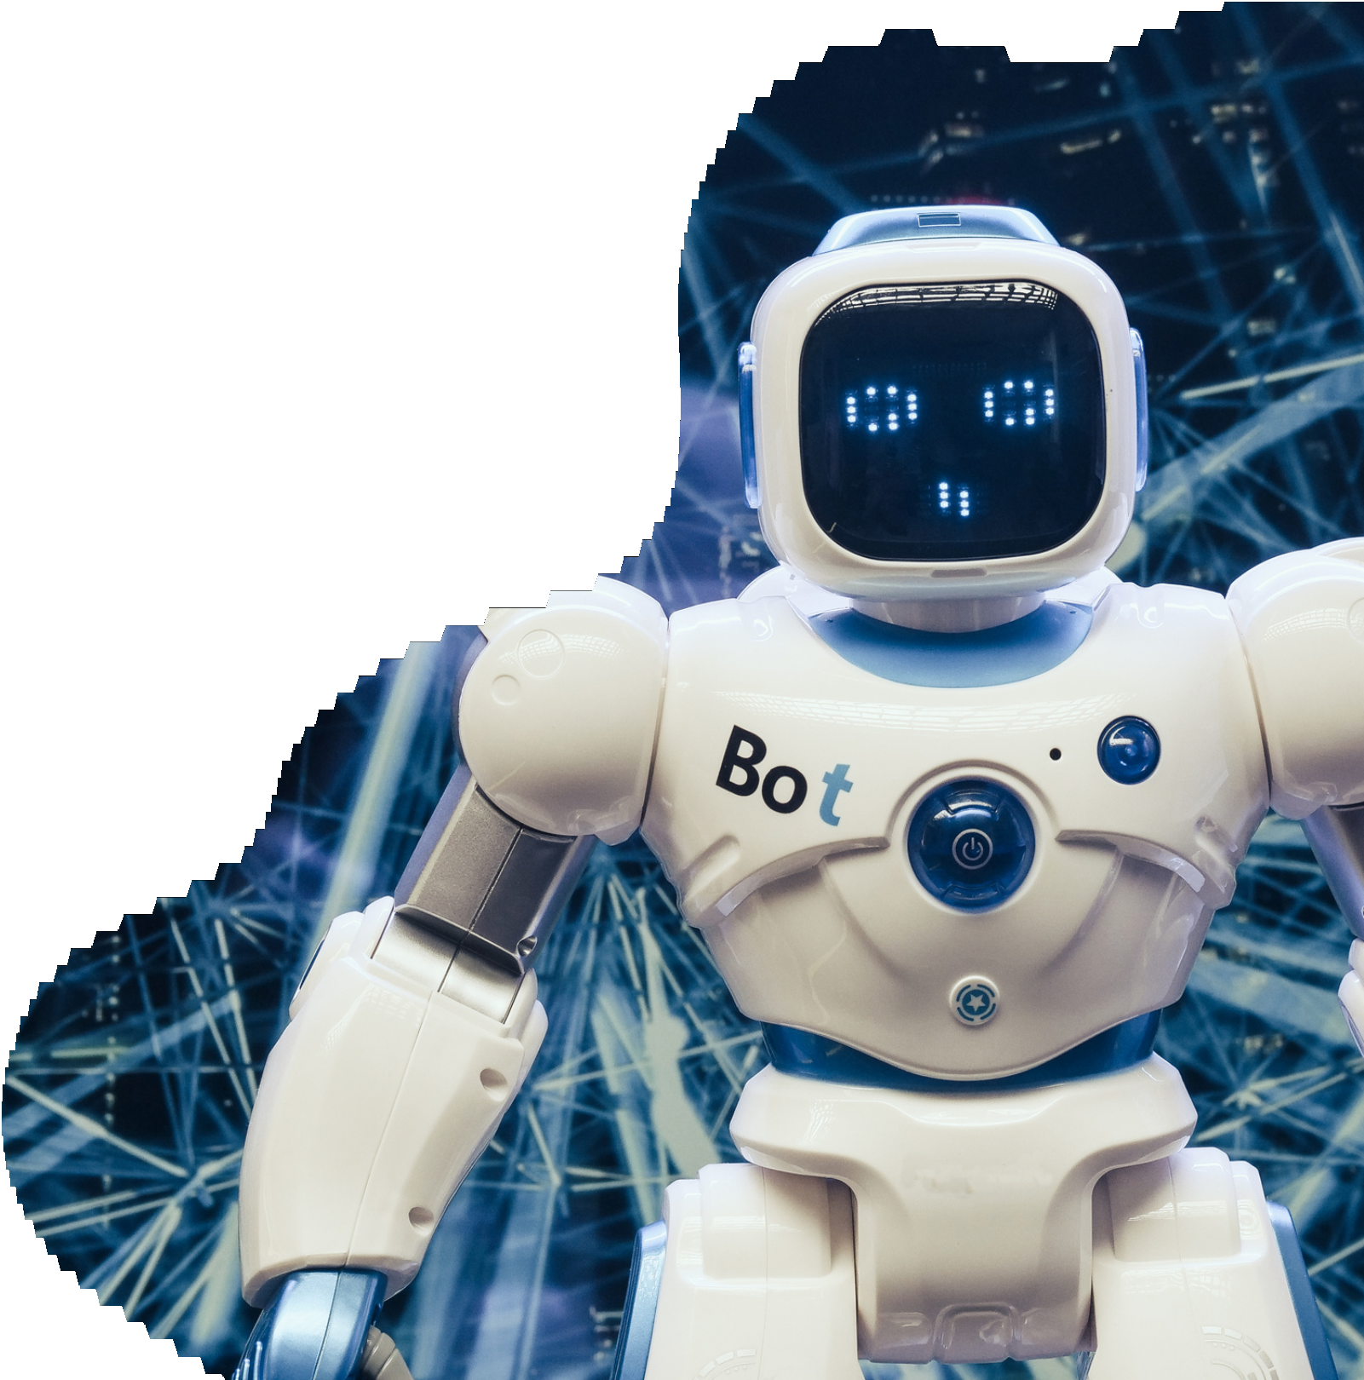
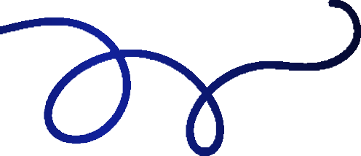







Bots & Fake Accounts
The users who have liked every single photo on the site will be considered as bots
We have 13 such users based on the data who have liked all 257 posts, user-Id for the same are specified below.
5
14
21
24
36
41
54
57
66
71
75
76
91
Investor metrics

Slide 14


APPROACH
For this project, I have used My SQL to extract the required data from the given database using the Join function, subqueries,
Aggregation, where condition, Group by, Distinct and other functions required.
keeping the Primary key and foreign key in
consideration provided all the reports asked by the marketing department and Investor metrics department.
I have used canva for making this presentation as it contains required Elements, Graphs,
Images which made this project more attractive.

Slide 15
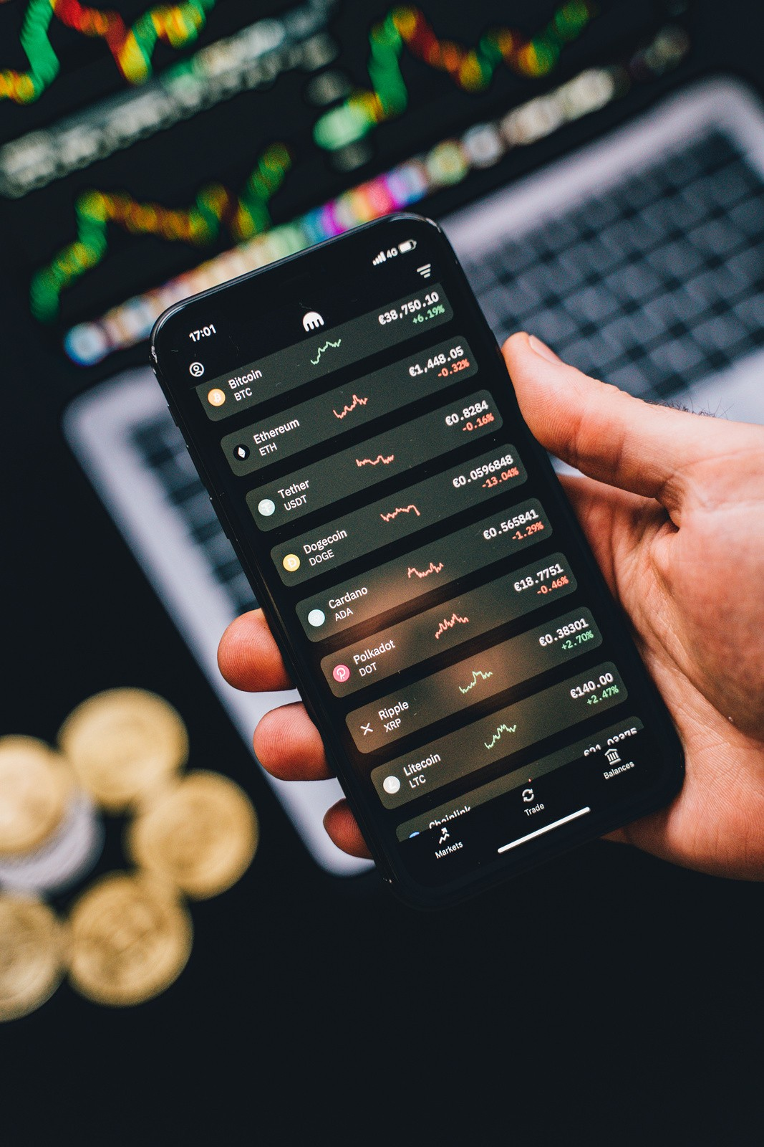
Insights and Results
From this project, I got an idea about how as a business or data analyst we work on real-time data to take any data-driven decision.
One thing I infer about this project is the dataset provided was very limited and small in respect of Rows and columns, But still, it was a very good experience working on such kind of project.
It helped me a lot to understand the analysis process well, and to provide insights for the best decision possible

